Slide 1
Introduction to Data Science in R
Pat Callahan
UCSF Memory and Aging Center
6/??/2020
Notes:
Everyone is going to be on mute by default
Want to review some of the most important topics in the R ecosystem
Feel free to ask questions in the chat, and please note the slide # that your question pertains to. This presentation will come in two parts, a general intro to R followed by a quick dive into the Tidvyserse packages. The second part of the presentation will take place next week.
Please, make note of topics where you think another presentation would be useful!

Slide 2
Presentation Goals
R Language quickstart
Overview of R’s Core features (and quirks)
Introduce the {tidyverse} Packages
Notes:
Can’t begin a discussion of R without introducing the idea of functional programming, for which R is heavily known
My goal is not to give you all of the information on every topic; there’s simply too much to cover, and so I want to do what I can to tie together a lot of these disparate topics
More of a starter pack for many of the topics
Some of the technical details I’ll give you are half-truths or white lies, and I’ll do my best to let you know when something is a rule vs. an expectation
Overall approach to this discussion is from a data science perspective
The first two goals will comprise today’s lecture, and the third goal will be next week’s topic

Slide 3
Functional Programming
Definition is arbitrary, and somewhat ethereal
Concept, !framework
Computation by evaluating functions
Programs written under assumption of (relatively) immutable data structures
X -> Y, always
Notes:
Some of you may have previously heard of object-oriented programming which is a mainstay concept in coding languages
It’s possible to do OOP in R, but it’s really known for being functional.
What does functional mean? Arbitrary concept, no hard-set definition; it’s a concept rather than a digital framework of some sort

Slide 4
History of R
Derived from the S language in the 90s
Initial 1.0 release February 2000 (Ihaka and Gentlemen)
Reached 4.0.0 in April!
Designed specifically as an open-source tool for statistical analysis
Extensibility
Notes:
Note that upgrading to 4.0 might cause problems. IF YOU ENCOUTNER A PROBLEM ON MacOS: I recommend deleting all R/RStudio installation files, and redownloading
Contact me if there’s a need for resources on how to do this

Slide 5
R Cons
Derived from S, but also implements C and FORTRAN
Technical debt; some oddities in code
Can have a steep learning curve
Base R function error messages can be obtuse
Ugly base graphs
Lost in a maze of packages
Notes:
If you’ve ever made a point plot or a line plot using base R, I hope you agree
If any of these are somehow a deal breaker, there are alternatives…

Slide 6
Alternatives
Python
MATLAB
JavaScript
Julia
SAS
Others

Slide 7
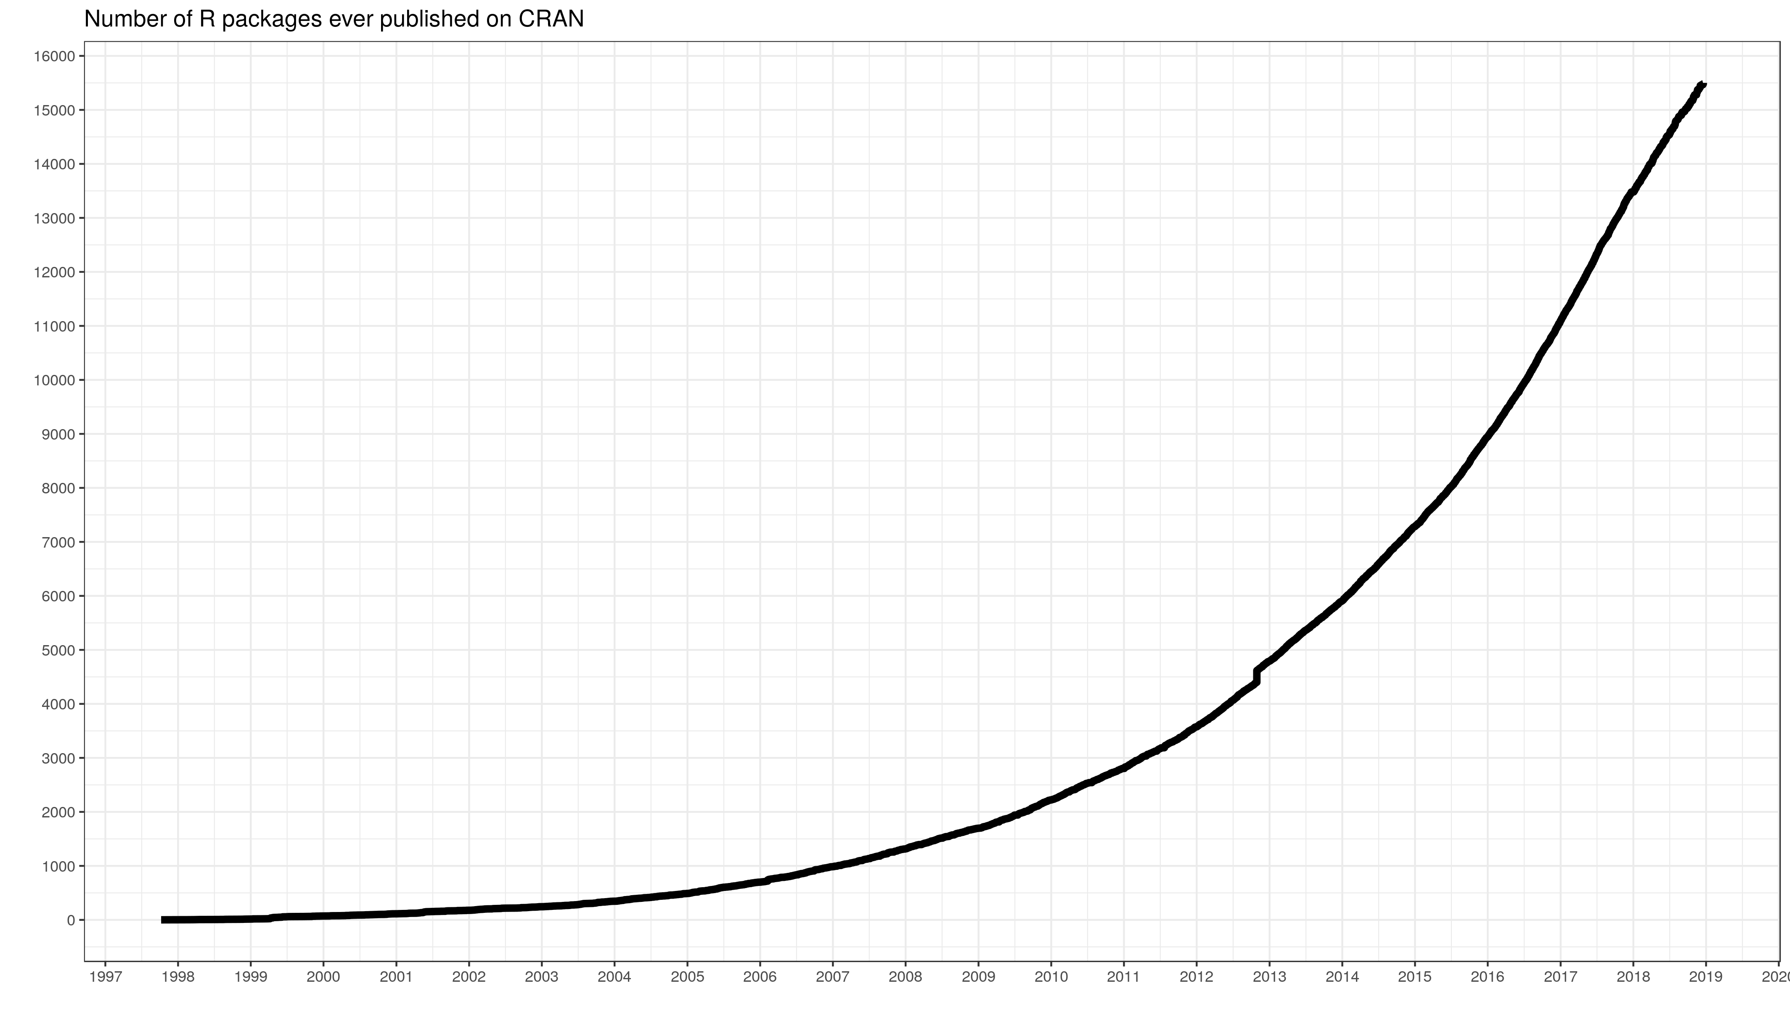
R Pros
$$$ Free! Now and always
Incredible documentation and help networks
Stack Overflow, RStudio Community, GitHub, etc.
Widely implemented in research and data science jobs
Widely-taught at the undergraduate level
Current and future colleagues will know R
13th most popular programming language overall
Open source packages
>15,000 total on CRAN
Variety of packages
Notes:
My understanding is that Berkeley has transitioned their data science program focus, and most of their biological sciences course, over to using R.
This parallels my undergraduate experience—a clear shift from MATLAB to R

Slide 8
Getting Started
Download R from the R Project website
Optional: download Xcode (Mac) or {rtools} (PC)
Needed for compiling some R packages
Download RStudio interactive development environment
Technically optional, but you’ll hate using the base IDE

Slide 9
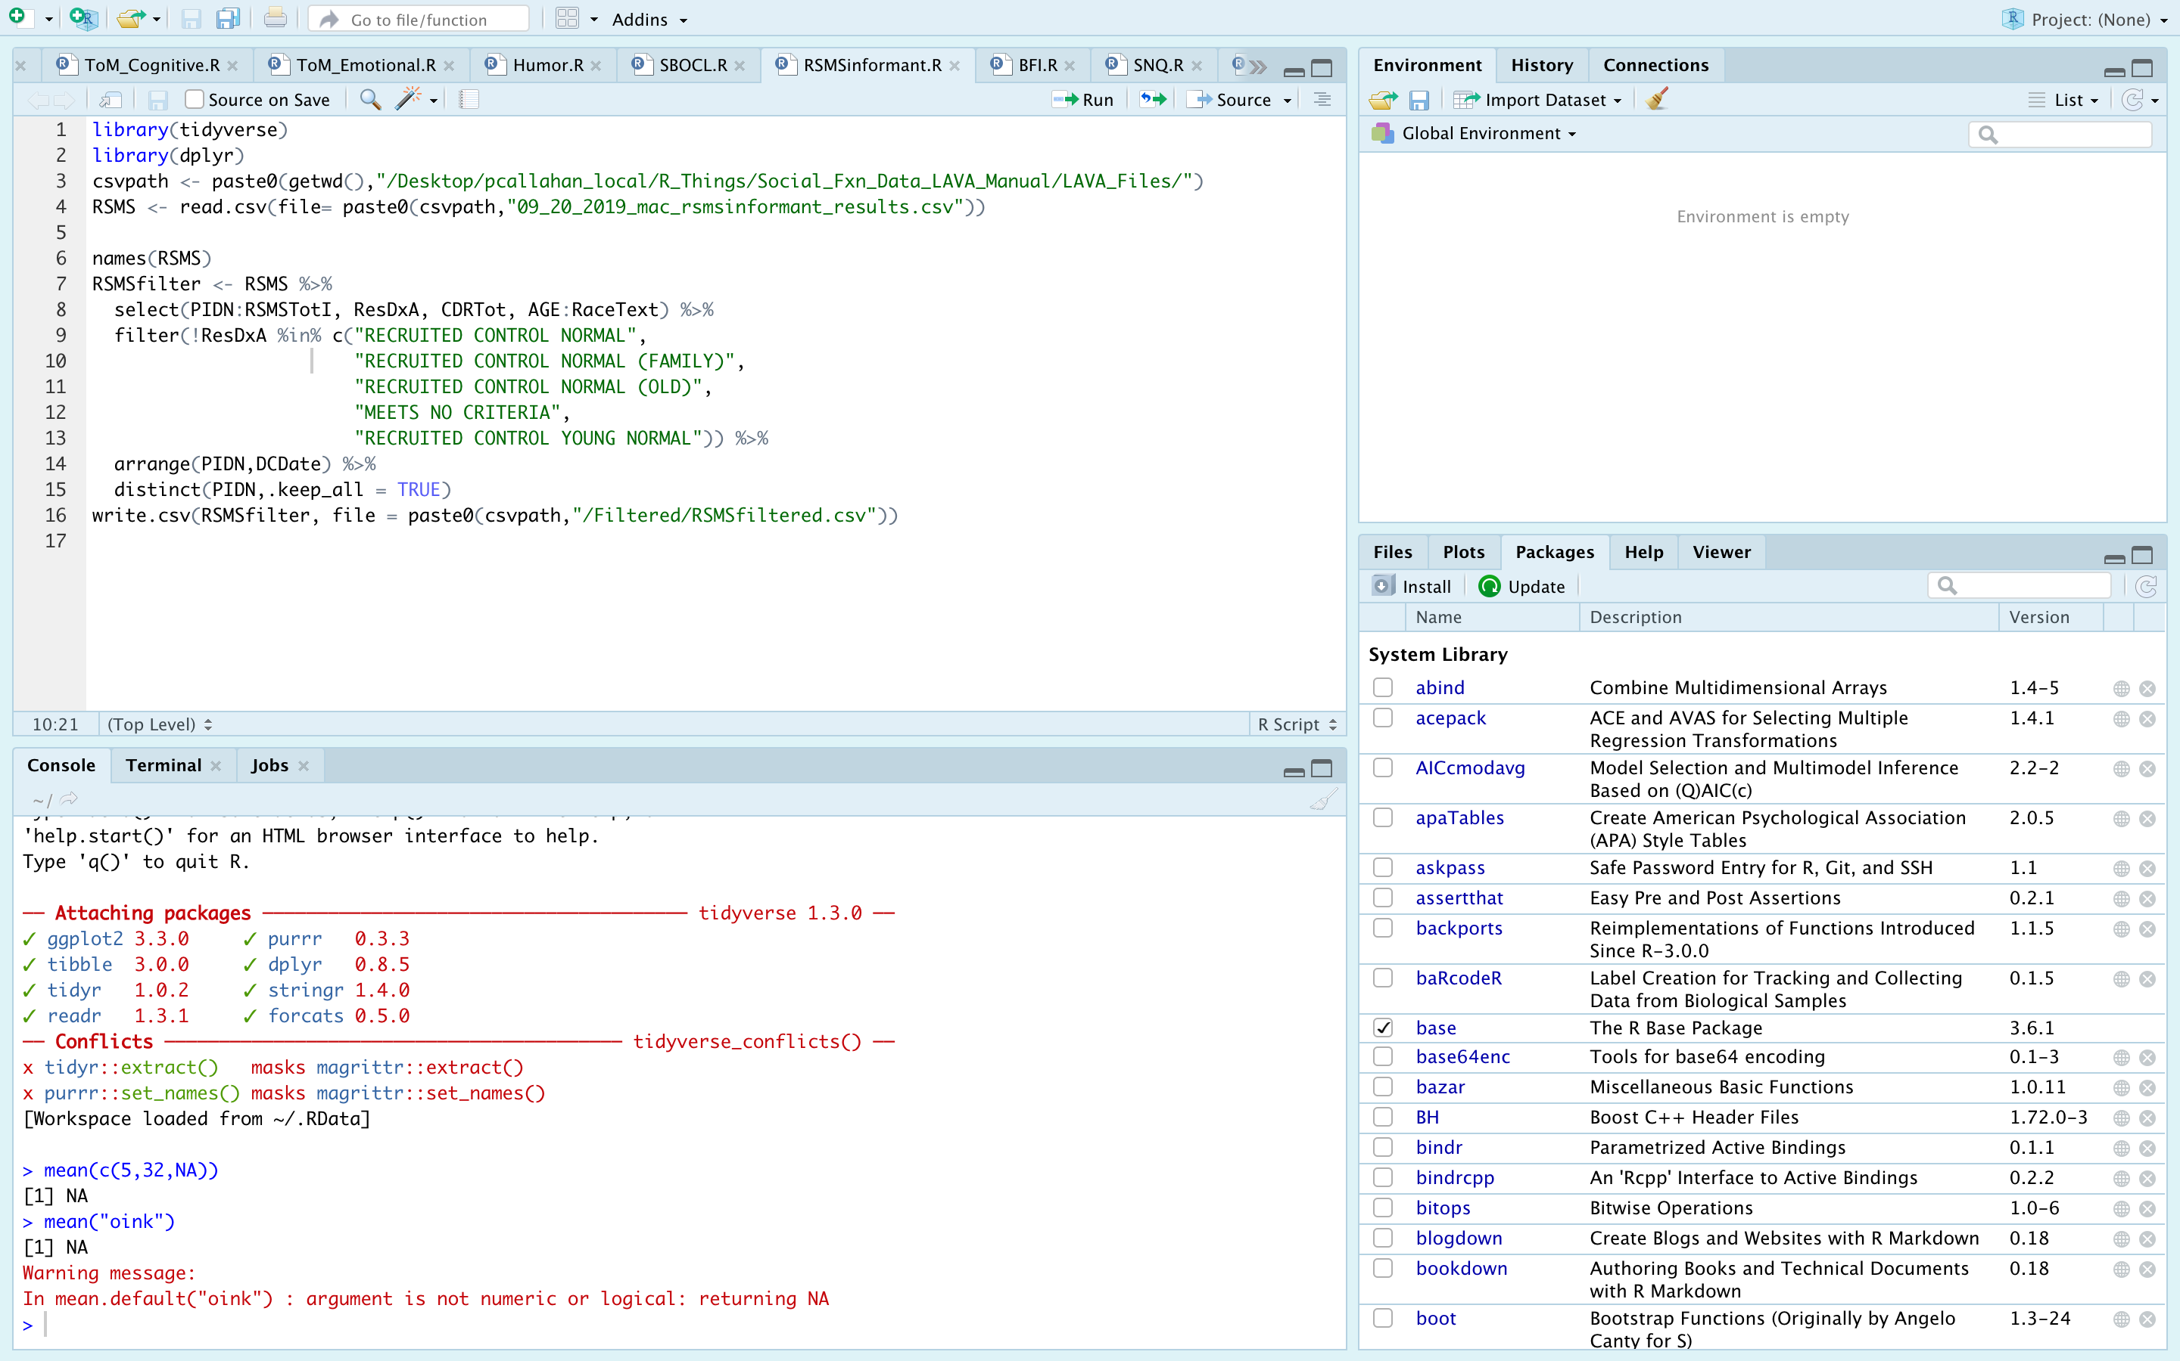
Notes:
Appearance of RStudio. You can ignore any specific text for now—I want to point out the 4 major panes…

Slide 10
Notes:
Four sections typically referred to as: source, environment, console, and viewer/help window
If you look closely, you’ll see that each of these panes have multiple tabs. I’ll discuss each tab generally, but the tabs currently open are the most commonly used.

Slide 11
Notes:
Source: contains all of your open .R and .Rmd files. Can run the entire script by pressing the Source button, or run line-by-line with Run

Slide 12
Notes:
Environment: shows all objects in your environment. In this case, I have no objects saved to my env!
History: shows the history of the lines you’ve run in this session
Connections: if you connect to a database a la a SQL connection

Slide 13
Notes:
Console: shows the code you just ran, and prints out the results of that code
Terminal: you can run bash or shell commands here
Jobs: tells you what, if anything, is running in RStudio. I never use this.

Slide 14
Notes:
Viewer/helper
Packages: shows you all of the packages you’ve downloaded and options to install/update
Files: shows you the files available in your current working directory
Plots: will show you any plots that you’ve generated using R during this session.
Help: frame that pops up when you call for help on a function. I’ll cover this later in the talk
Viewer: opens various R objects that aren’t plots or help files. Won’t be covered—separate topic

Slide 15
Simple R Syntax
Object assignment:
Use <- or =
Function calls:
Foo(.x, …)
Notes:
Start a note line using “#”
Reserved namespaces
TRUE, FALSE, if, NA, NULL, arithmetic operators (+, -, etc.)
Objects where the name starts with “_” or numbers
Case sensitive
Notes:
Should technically use the carrot-dash rather than equals when assigning variables due to some precedence rules that exist in R
Reserved namespaces == don’t try to create objects in R using these names

Slide 16
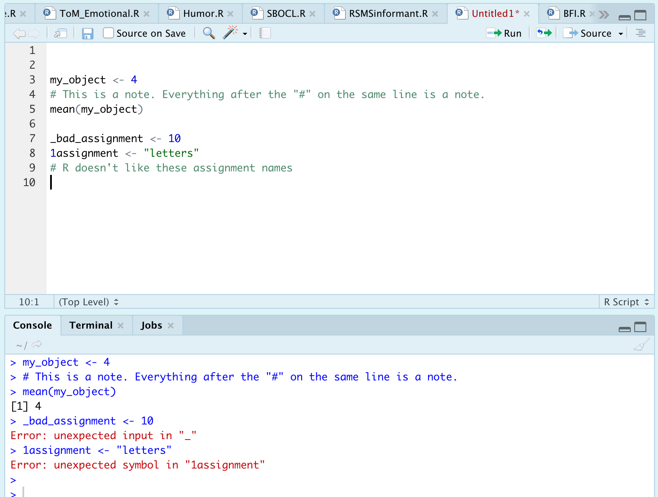
R Syntax: Examples
Notes:
In the Source area, I ran the script
Results came out in the Console
Let’s quickly review this line-by-line
Really important note: the assignments I’m creating are now known as objects
Keep that term in your head
A dataframe is an object, a single number is an object, a function is an object.
It’s a general term for something that exists in your R environment

Slide 17
R Infix Operators
Functions/methods enabling basic expressions
“Infix” refers to the placement of the operator between two variables
What you’ll care about in the beginning:
+, -, *, /, ^,>, <, >=, <=, ==, &, |
Complete list at http://applied-r.com/data-infix-operators-in-r/
Notes:
In most contexts, these infix operators represent their normal arithmetic operations

Slide 18
Booleans
Represent the outcome of a binary evaluation statement
FALSE or TRUE
R also represents booleans as numeric values 0 and 1
This is done under the hood, but means you can perform calculations with boolean values
Notes:
Fancy way to say FALSE/TRUE situation

Slide 19
And/Or
Vectorized evaluations
The & operator is “and”
Each statement to an & statement requires explicit arguments. That is, `data = 4 & 5` is not valid while `data = 4 & data = 5` is
There is a short cut for some instances like this: %in%
The | operator is “or”
Same rules apply as in the “and” statements
&& and || are scalar versions of these statements
Returns only a single TRUE or FALSE statement

Slide 20
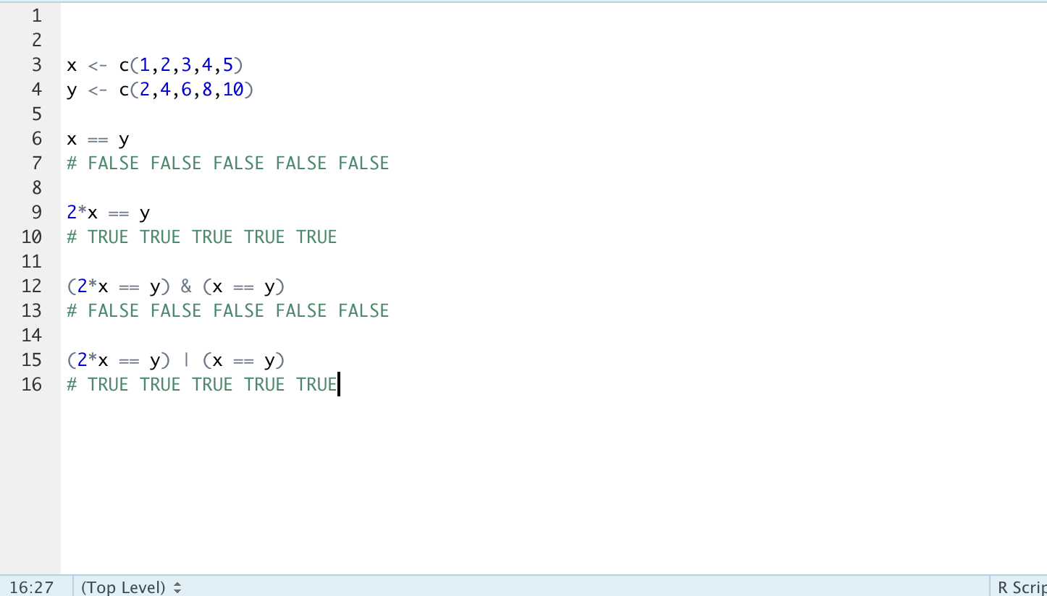
And/Or: Example
Notes:
Simple demonstration—can create significantly more complex evaluation
Creating two vectors of numbers
Note the use of c() and commas separating each number
Operation evaluates if each item in the vectors are equal
Obviously, they are not. Can perform math operation to make them true
Use of & and | operators

Slide 21
R Classes
What is a class?
Implicit object meta information
Alters how functions can/will treat the data
Why does this matter?
Troubleshooting and running functions!
What are the core classes in R?
Character, factor, numeric (integer or double) logical, raw, complex
Check classes with class()
Notes:
New topic! Object classes in R
Implicit because you rarely need to declare the class of an object. R guesses classes, and is usually pretty good at doing this.
Raw and complex grayed out because you will likely never see them
Important! Strictly speaking, classes aren’t the full story here, but they’re what really matters. The deeper underlying data structure is the “type” of the data
I find the information regarding “type” to be less informative, however, and troubleshooting ”class” is sufficient 99% of the time

Slide 22
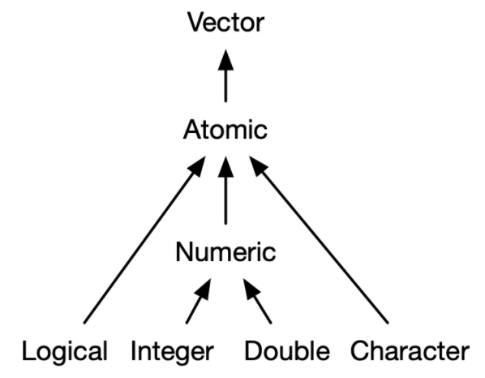
R Classes: Atomic Hierarchy
Most
specific
Least
specific
Notes:
I want to introduce this diagram right now; we’re going to revisit it with an in-depth discussion in a few slides.
Take some time to think about the specificity arrow, and how objects combine with one another

Slide 23
R Classes: Logicals
TRUE/FALSE values
Can use T and F as shortcuts
Stored as integers internally
0 = FALSE
1 = TRUE
Notes:
Completely straightforward
R represents TRUE and FALSE as integers under the hood so you can do math with them. With that, let’s review the numeric classes

Slide 24
R Classes: Numeric
Can be represented as either integer or double
Integers can be explicitly declared by typing “L”
Ex: the integer ten can be explicitly written 10L (not always required, but aids in clarity)
Really only impacts processing speeds, but important to know as you will see both
Notes:
Numeric is a catch-all for integers and doubles. You’ll probably see “numeric” listed most of the time, but good to recognize the sub-classes
Integers are, well, integers, Any whole, real numbers.
R processes integers a bit quicker, but it’s unlikely most of us are dealing with data where this is a concern
We are scientists, not mathematicians so we don’t need to respect integers
Doubles are any real numbers that aren’t integers

Slide 25
R Classes: Characters
Alphanumeric values (i.e. strings)
Numbers alone usually recognized as numeric
Numbers with letters will be set as character
Cannot perform mathematical operations on characters
Obvious, yes, but sometimes expected numbers are actually listed as characters
Can use string manipulation methods on characters
grep() functions
{stringr} package

Slide 26
R Classes: Factors
Often has a similar appearance to characters
Ex: c(“easy”, ”medium”,”hard”) are natively characters, but can be changed to factors
Store data in ordered levels
Declare with factor(x), and argument levels = …
R will use alphanumeric order if levels is unspecified
Why use factors?
Requirement for many functions
Notes:
Surprise topic!
Similar to character in that you will see strings printed out and words can still be read by you as a character class would
Many functions require certain variables to be factors.
A good example of when you’d want to make this change is with PIDNs on your datasets. Those are discrete variables, but R will read them in as numeric and thus continuous values.
Return to my earlier anecdote about classes vs types. This is one important place where you should have this anecdote in mind. It will save you a lot of time when working with factors

Slide 27
R Classes: Factors
Factors contain levels represented by numbers
Initial levels determined by alphanumeric order
*Underlying data structure is an integer!*
Class() = factor, but typeof() = integer
Help and troubleshooting
Base R: factor(), ordered(), and relevel() for help
{forcats} package, my recommendation
Notes:
Factors warrant their own discussion because of how important they will be for grouping analyses
Factor levels
Alphanumeric order is default; can be confusing
Factors can look like other classes when printed, but they will behave differently when we use functions
String manipulation on letters won’t work
Exercise: make a factor out of “easy” “medium” and “hard” to see the ordering results

Slide 28
R Classes: Important Functions
Will often need to check classes and convert between classes
Check classes
Class()
Is.factor(), is.numeric(), is.character(), as.logical(), as.date()
Change classes
factor(), as.numeric(), as.character(), is.logical(), is.date()
Notes:
Factors warrant their own discussion because of how important they will be for grouping analyses
Exercise: make a factor out of “easy” “medium” and “hard” to see the ordering results

Slide 29
R Structures: Vectors
Every object is a vector (for the most part)
Vectors are sequences of items of the same data type
WARNING: R will make every item be the same data type
”Atomic vectors”
Functions care about vector classes!
Notes:
We’ve reviewed the important types of classes. Why? To understand vectors
Idea of the atomic vector; that is, vectors where all elements are the same class

Slide 30
Remember me?
Most
specific
Least
specific
Notes:
So we’ve covered the order of specificity of these classes
You’ll see everything points to Atomic and then Vector
Vectors want to be atomic, and that just means everything in the vector is the same class

Slide 31
R Functions
In general, you supply an object and a set of arguments
Object is typically a vector or dataframe
Arguments should be named explicitly
R accepts positional and partial matching, however
Idea and syntax will be similar to most other programming languages
User-defined and built-in functions
Notes:
You should already be familiar with the idea of a function so I’m not going to cover this as a concerpt
I will talk about functions in R
What do I mean by explicit argument naming:
Example of a function that takes the arguments data, arg1, and arg2

Slide 32
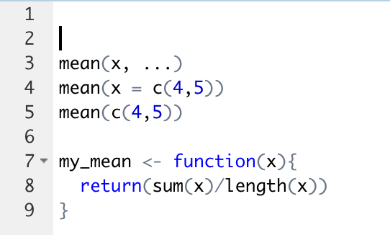
R Functions: Example

Slide 33
R Functions: For Loops
Can use for loops to iteratively generate values when needed
However, R is already a vectorized language
Objects are stored as vectors, and functions will process objects as such
Avoid for loops!
Comprehension
Speed, speed, speed
Notes:
I was taught for loops by my professors in undergrad, but they probably learned to do these in other languages where it makes sense so it’s a place where I depart drastically.
In summary, I will delete your code if you write a for loop

Slide 34
R Structures: Lists
Can be thought of as similar to a vector except all objects retain their identities
Ex: list(1, TRUE, “character”, factor(hello, goodbye))
Objects in a list can be anything: a vector, a single number, multiple data frames
Lists can contain lists!
Powerful feature useful for iterative processes, nested data, and other situations
Notes:
In the example, all of the objects retain their identity. 1 is numeric, TRUE is a logical, character is well a character, and hello/goodbye are factors.
If this were a vector, however, everything would have been reduced to the lowest common denominator which is a character
Lists aren’t a huge deal for our purposes because most of you will be working with flat files, but you’ll encounter them more as you get more advanced

Slide 35
R Structures: Matrices & Arrays
Matrix: unlabeled N x M data space
Transposable (if ever needed)
Useful for speed + efficiency
Must be atomic
Array: stacked matrices
Notes:
Again, going to disrespect mathematicians here. There’s not much use for matrices and arrays in most of our work unless you’re working with ultra high-dimensional data

Slide 36
R Structures: Data frames
Bread and butteR of data representation
csv, .xlsx, .rdata
Generic term for storing data in a 2D format
Rows = observations, columns = variables
Implemented in a variety of packages and manners
Generic R method, {data.table}, {tibble}
How do I know what kind of data I have?
Class() fxn
Dependent on package used to read-in data

Slide 37
*Tibbles*
Base R data table structure
stringsAsFactors = TRUE
Printing method (ugly)
Data.table
Fast
Still ugly
Tibbles
Simultaneously data frame, data table, and tibble
stringsAsFactors = FALSE
Designed to work with {tidyverse}
Superior print method
Notes:
I previously mentioned that R has some baggage associated with it
Base data frame sets stringsAsFactors = T (super annoying), prints the whole object
Keep an eye out for the vroom package

Slide 38
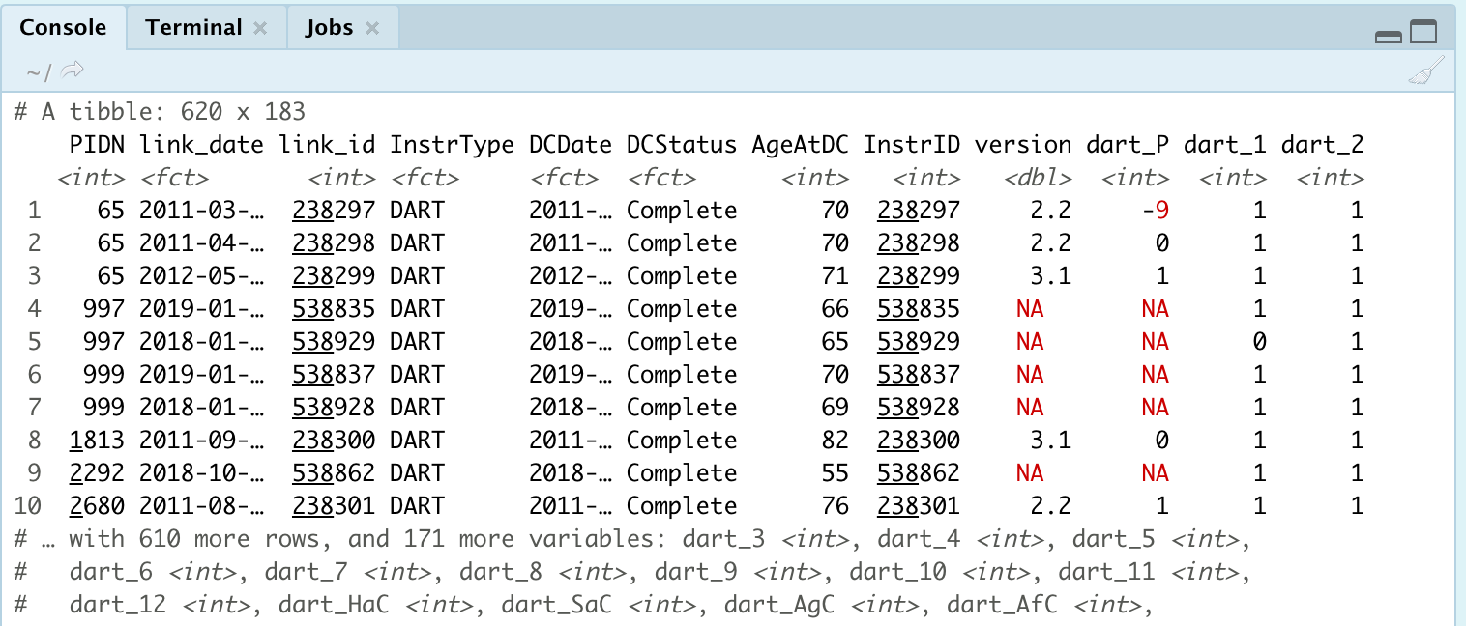
Tibbles: Example

Slide 39
{tidyverse}
Notes:
A tibble is one of the principal components of the tidyverse so this is a good transition point

Slide 40
What is the {tidyverse}?
Collection of packages that are indispensable in the R data science community
{ggplot2}, {readr}, {dplyr}, {tibble}, {stringr}, {purrr}, {lubridate}, {magrittr}, {glue}, {rlang}
Developed by Hadley Wickham and many others of the RStudio Team
Occasionally called the Wickham-verse
Notes:
What is a package? In R, it’s a set of functions someone wrote and published for you to download. When you download R, it comes with a ton of packages by default. Most commonly, you’ll see the {base} and {stats} packages

Slide 41
Learn {tidyverse} over any/all other packages
Notes:
Structure your learning around this
It is hands-down the most complete and most used ecosystem of packages
You will understand SO and RStudio community questions infinitely better when you see that most questions involve or include fxns from the tidyverse

Slide 42
Starting Packages
{ggplot2}
{readr}/{readxl}
Use read_csv() or read_excel()
{magrittr}
The pipe function, %>%
{dplyr}
5 verbs for data manipulation
Notes:
Core, essential packages to know from the tidyverse
Ggplot2 will be mentioned, but not covered in depth. That’s a whole separate series of presentations
We’re going to proceed in, what I believe to be, increasing order of importance

Slide 43
{ggplot2}
One of the 3 main plotting systems in the R ecosystem
Lattice and base
Consistent syntax for plotting data, highly customizable, and good looking out of the box
Too much to cover for this lecture
Notes:
Three main plotting ecosystems tradtionally: base R, lattice, and ggplot2.
Base R is ugly, although improved with 4.0 release
Lattice has fallen by the wayside. It tried to be a mix of base R and ggplot2
Ggplot2 undoubtedly most popular, take my word for it. BBC, 538, and other websites actually build graphs using ggplot2 (with their own custom themes—you can actually download the BBC default themes.) I present no further proof.
Also take a look at plotly and gganimate for interactive and/or animated graphs

Slide 44
Starting Packages
{ggplot2}
{readr}/{readxl}
Use read_csv() or read_excel()
{magrittr}
The pipe function, %>%
{dplyr}
5 verbs for data manipulation

Slide 45
{readr}
Multiple functions for reading and writing delimited files
Tab, colon, period, etc.
Functions you’ll care about
readr::read_csv(“./Files/data.csv”)
readxl::read_excel(“./Files/data.xlsx”, sheet = 1)
Working directory!
getwd() and setwd()
here::here()
Notes:
New item! Note the {package} and :: combination. This notation allows you to explicitly call function X from package Y
You all will mostly care about these two functions
When reading in data using these functions, they start looking for the file you name from the current working directory. You can find out your current working directory by typing getwd() which is just useful information to know. Take a look at the notation “./File/data.csv”
Let’s say my wd is my Desktop so on my MacBook that’s "/Users/pcallahan/Desktop”

Slide 46
Starting Packages
{ggplot2}
{readr}/{readxl}
Use read_csv() or read_excel()
{magrittr}
The pipe function, %>%
{dplyr}
5 verbs for data manipulation

Slide 47
{magrittr}
Package supplies the pipe, %>%, operator
Allows you to write functions in a continuous flow without wrapping excessively
foo(foo(foo(foo(foo)))))
Did I put the correct number of closing parentheses?!
Read the pipe as an “and then” statement
Read_csv(“data.csv”) %>% mean(col1)
Read in my .csv AND THEN find the mean of col1
Notes:
Also, my syntax for mean() is technically not a real function call, but we’ll get to that. Just want to demonstrate the idea concisely here.

Slide 48
Starting Packages
{ggplot2}
{readr}/{readxl}
Use read_csv() or read_excel()
{magrittr}
The pipe function, %>%
{dplyr}
5 verbs for data manipulation

Slide 49
Notes on {dplyr}
Developed as a coherent ecosystem for data manipulation
Improved syntax over base R data cleaning operations
Familiar to SQL users
Start with learning this package when it comes to data cleaning
Notes:
Familiar to SQL users—in fact, the functions we’re about to see are exact counterparts, and they generate SQL code under the hood so you can interact directly with a SQL database if that’s a need. Great if, for example, working with high dimensional data from an EMR or other database
Note that the predecessor the dplyr, plyr, is now an abandoned package. If you have code dependent on plyr, that’s fine—it will keep working. However, you should switch to dplyr
I note this because a lot of older StackOverflow results will talk about plyr, and you should know these are distinct packages

Slide 50
{dplyr}: select()
Allows you to choose columns from a data frame
Don’t need to quote column names
Special operators
Remove values with “-”
everything()
Can call series of columns with ”:”
var2:var15

Slide 51
{dplyr}: filter()
Create arbitrary conditions on which to filter the dataset
Generic function for cleaning normally down step-wise and verbose in base R
Base R: dataframe[var1 > 1, ]
Dplyr: filter(dataframe, var1 > 1)
Can accept any number of filtering arguments by separating with “,”
Note that the comma will be read as AND within any filter call
Notes:
Stats::filter and dplyr::filter WARNING. I always explicityl declare dplyr::filter because the stats package causes headaches

Slide 52
{dplyr}: mutate()
Create new columns in a dataframe
Do not need to pre-initialize the column like you would in base R
New column will automatically have N rows to match the dataframe
Essentially any operation or set of values is allowed
Ex: create a new column that is 2x an existing column

Slide 53
*Special Topic* {dplyr}: mutate_at()
This is a special version of mutate(), referred to as a scoped variant
Scoped variants exist for all dplyr verbs discussed today, but this is a mainstay for me
Allows you to apply a function or value(s) to existing column(s)
Ex: set out-of-bounds values (88, 99, etc.) to NA

Slide 54
{dplyr}: arrange()
Allows you to sort data on given column(s)
Default ordering is ascending, but can specify descending with desc()
Affects how the dataframe looks when viewed
WARNING: this will alter calculations that depend on row position
Notes:
So you can sort on multiple columns at once. The order in which you write the column names provides precedence information
View can be ascend and descend—main point is to get a view of your dataset

Slide 55
{dplyr}: summarise()
Allows you to create summary variables over the whole dataset
Often paired with the group_by() function to calculate summary vars over certain groups
Returns a tibble with just the results of the summary

Slide 56
Starting Packages
{ggplot2}
{readr}/{readxl}
Use read_csv() or read_excel()
{magrittr}
The pipe function, %>%
{dplyr}
5 verbs for data manipulation

Slide 57
{dplyr}: Worked Example
Order of operations matters
Imagine doing the following sequence without the chain operator
Feel free to ask about other operations you might want to do!

Slide 58
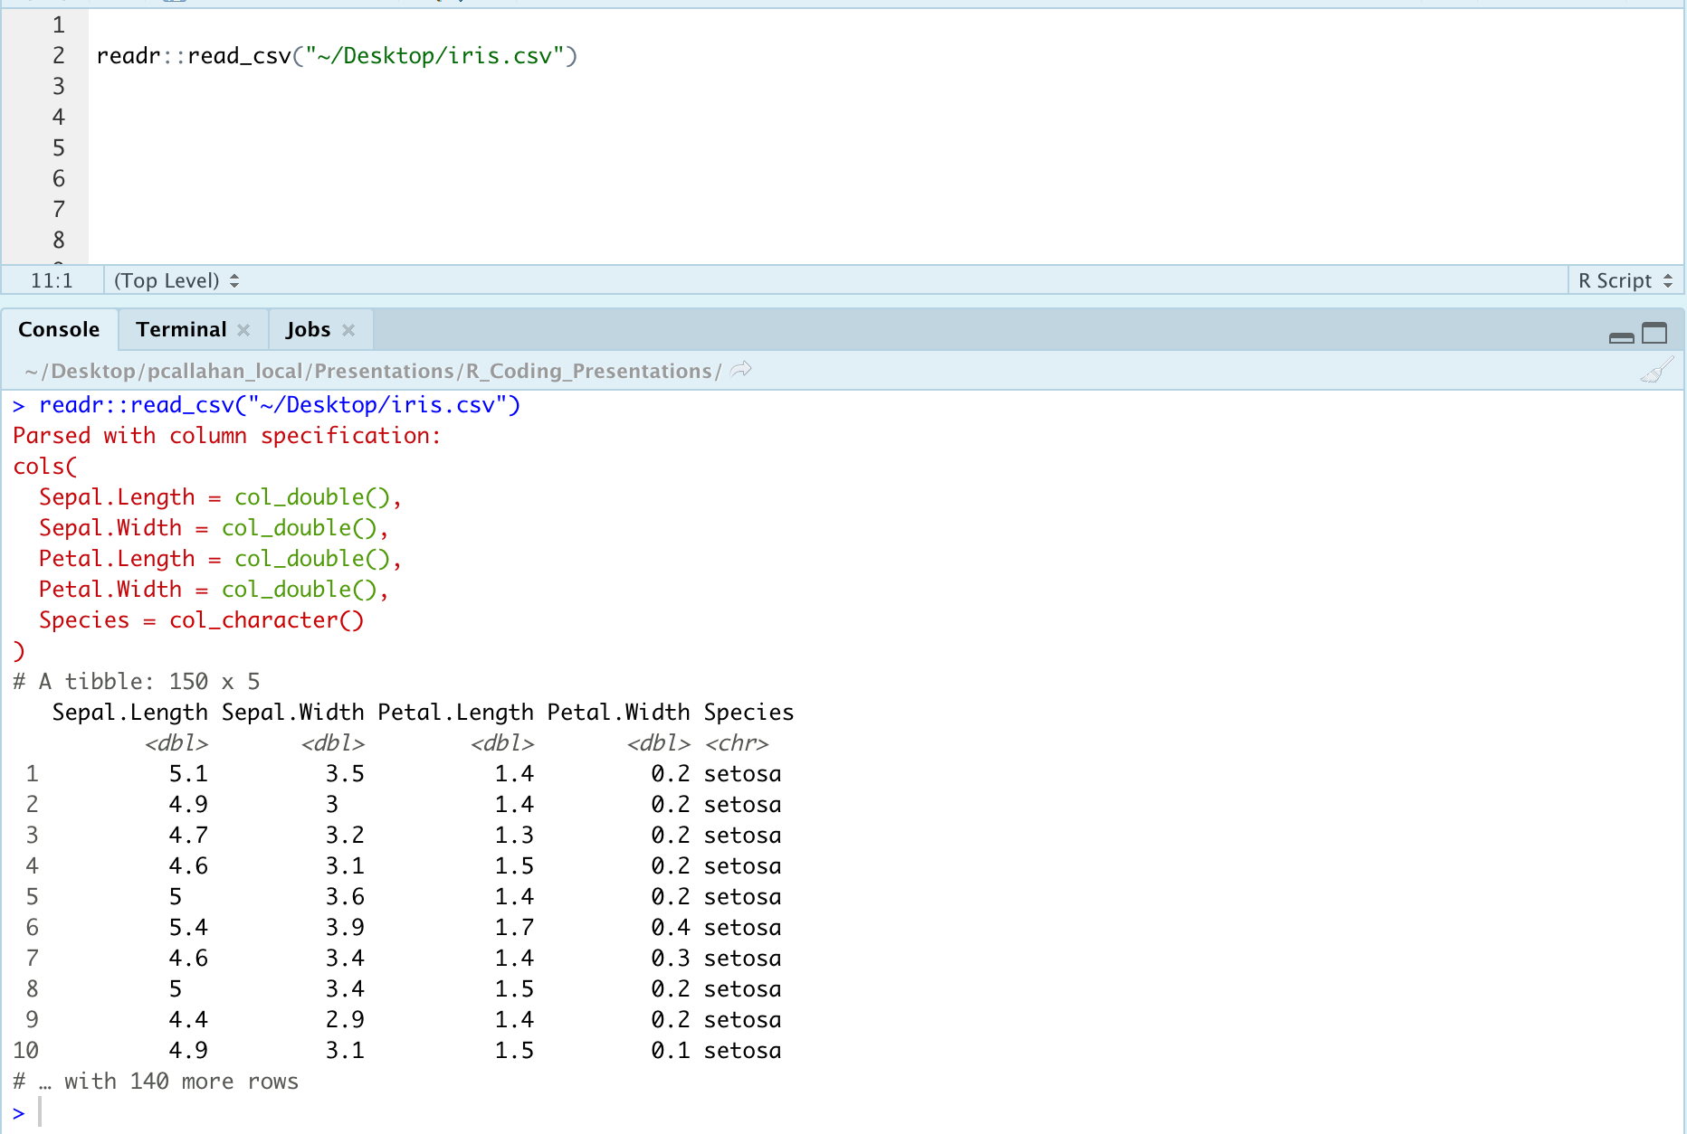

Slide 59
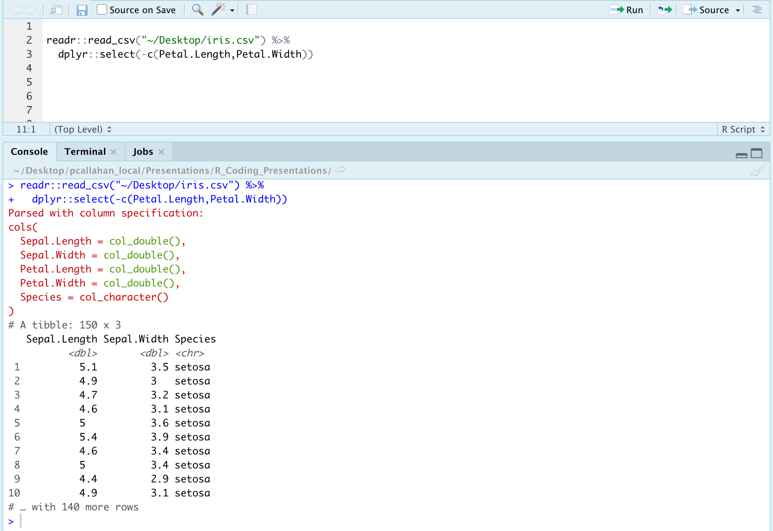

Slide 60
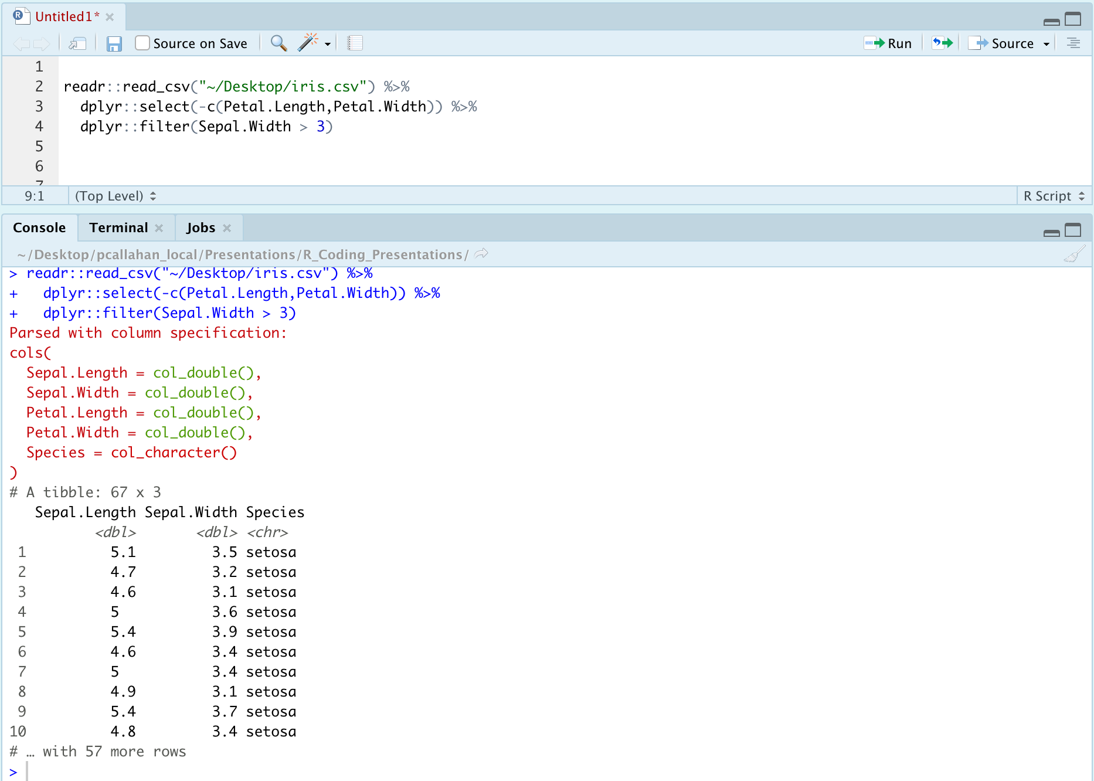

Slide 61
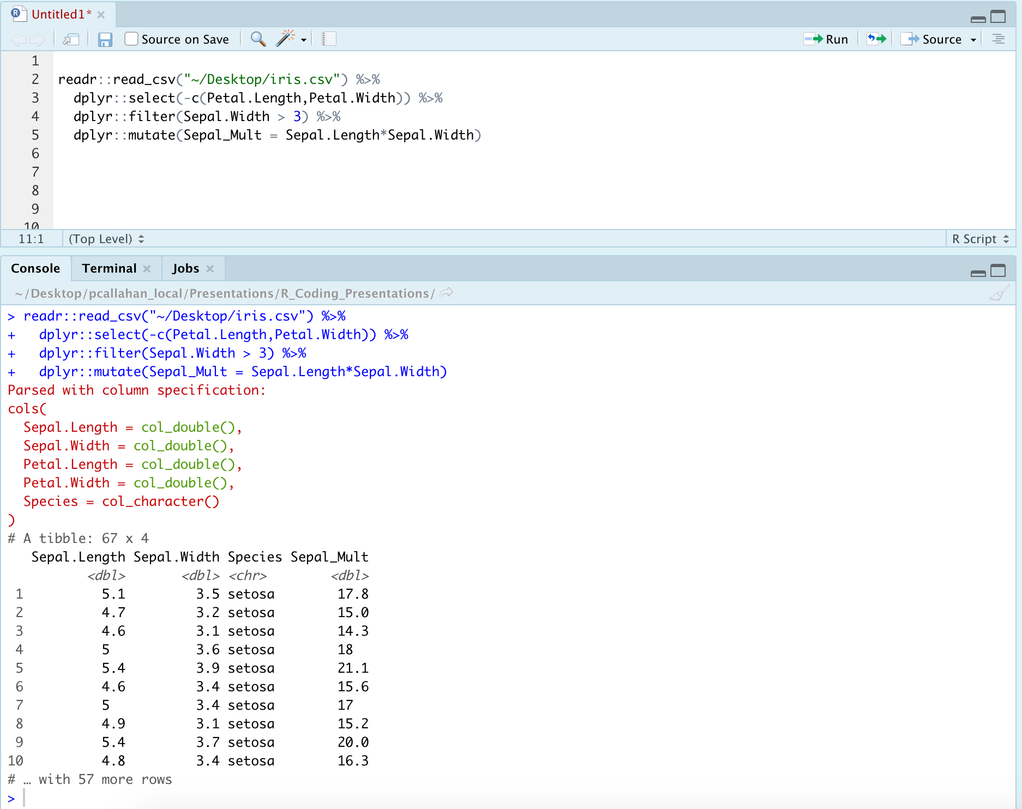

Slide 62
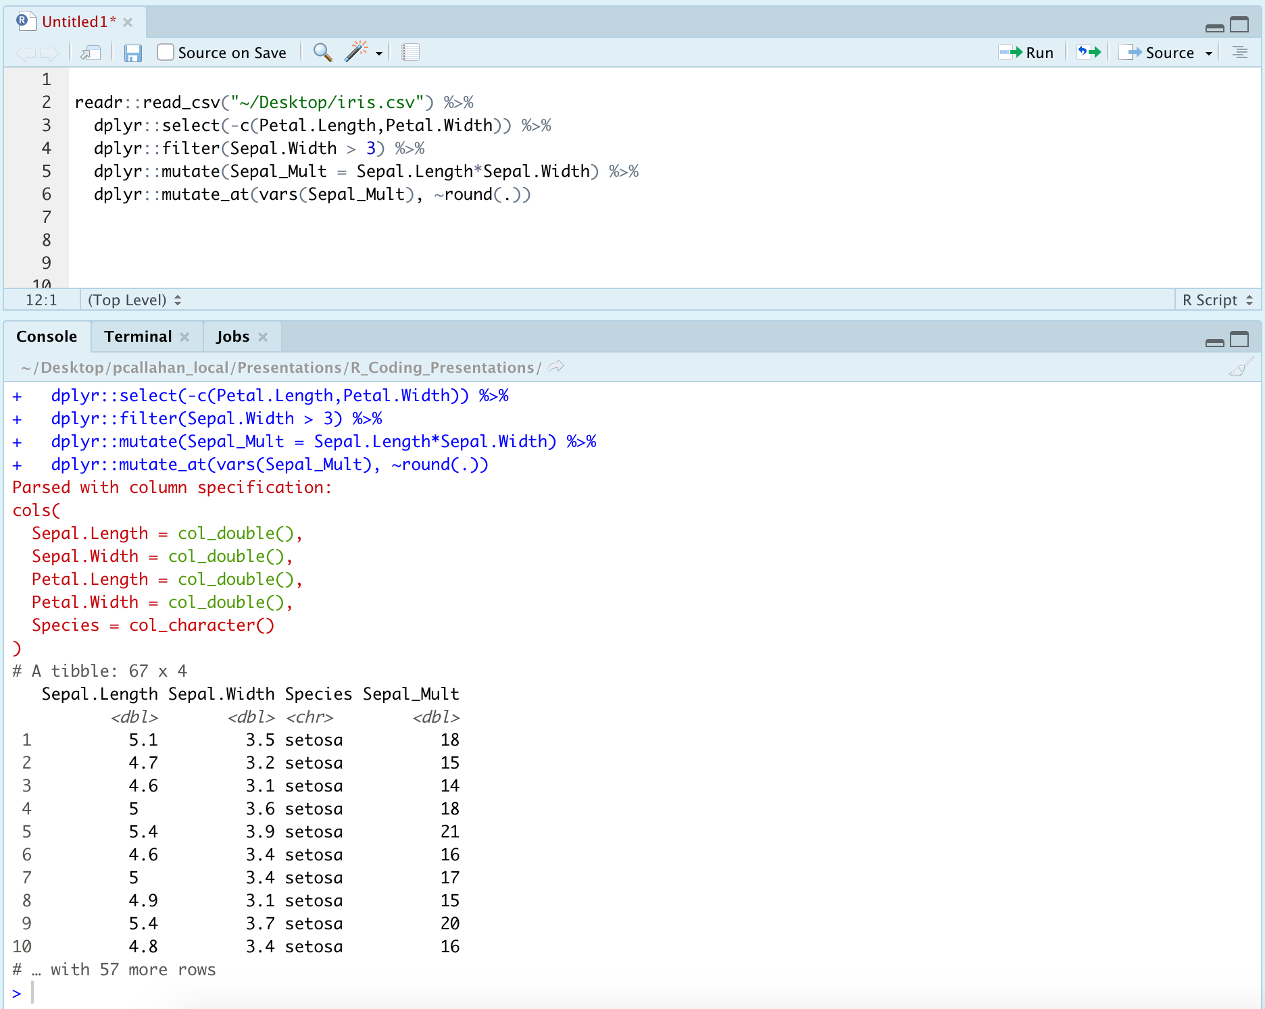

Slide 63
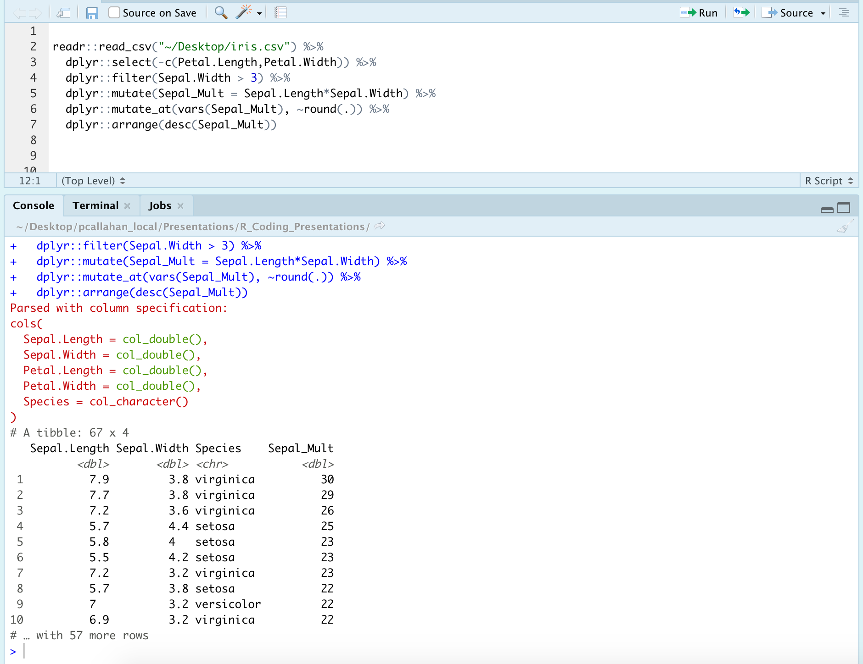

Slide 64
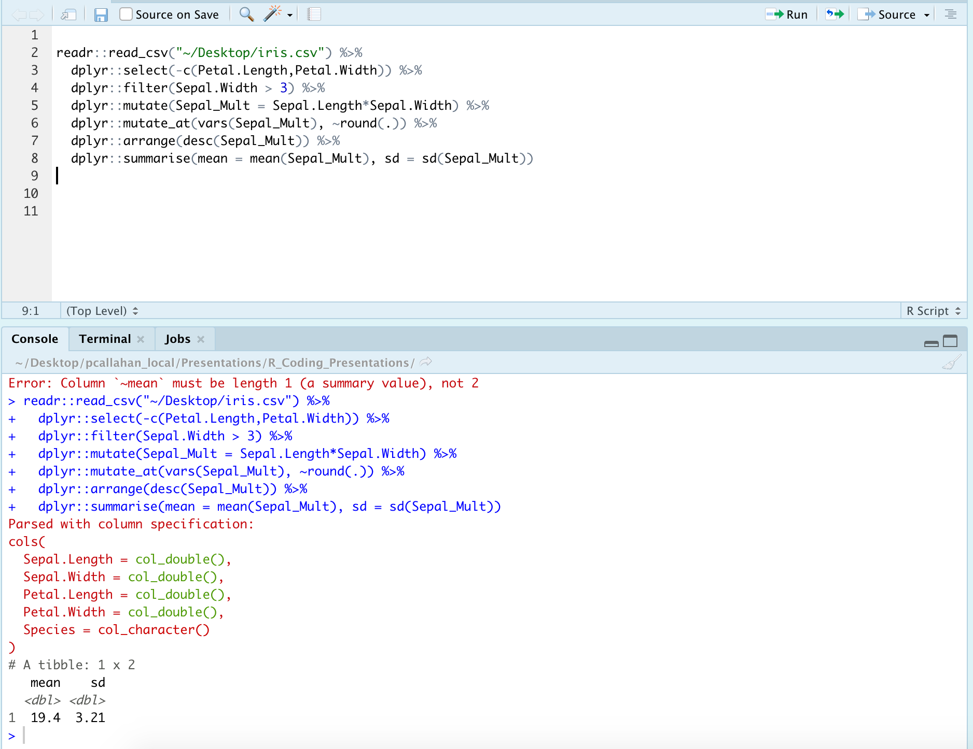

Slide 65
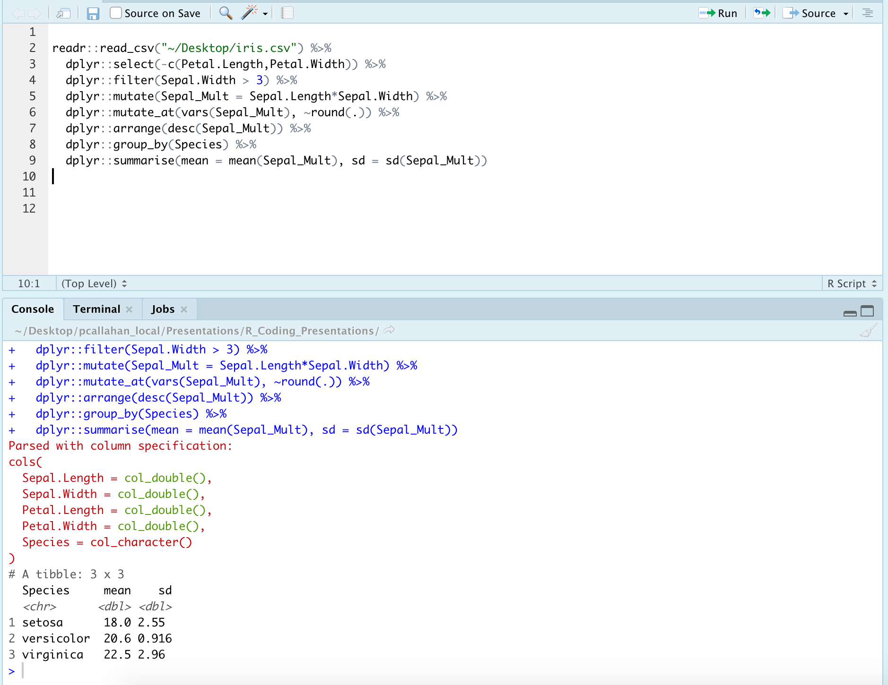

Slide 66
Other Packages, Discovering Data, and Troubleshooting
Notes:
Finished with our main presentation, and going to move on to some closing thoughts and things I think will be beneficial

Slide 67
Other Packages to Consider
{apaTables}
{broom}
{tidyr}
{usethis}
{purrr}

Slide 68
Exploration Tools
Look at your table in Excel or using View()
Quantitative information
str()
summary()

Slide 69
Help! (I need somebody!)
?foo or help(foo)
?foo or help(foo)
?foo or help(foo)

Slide 70
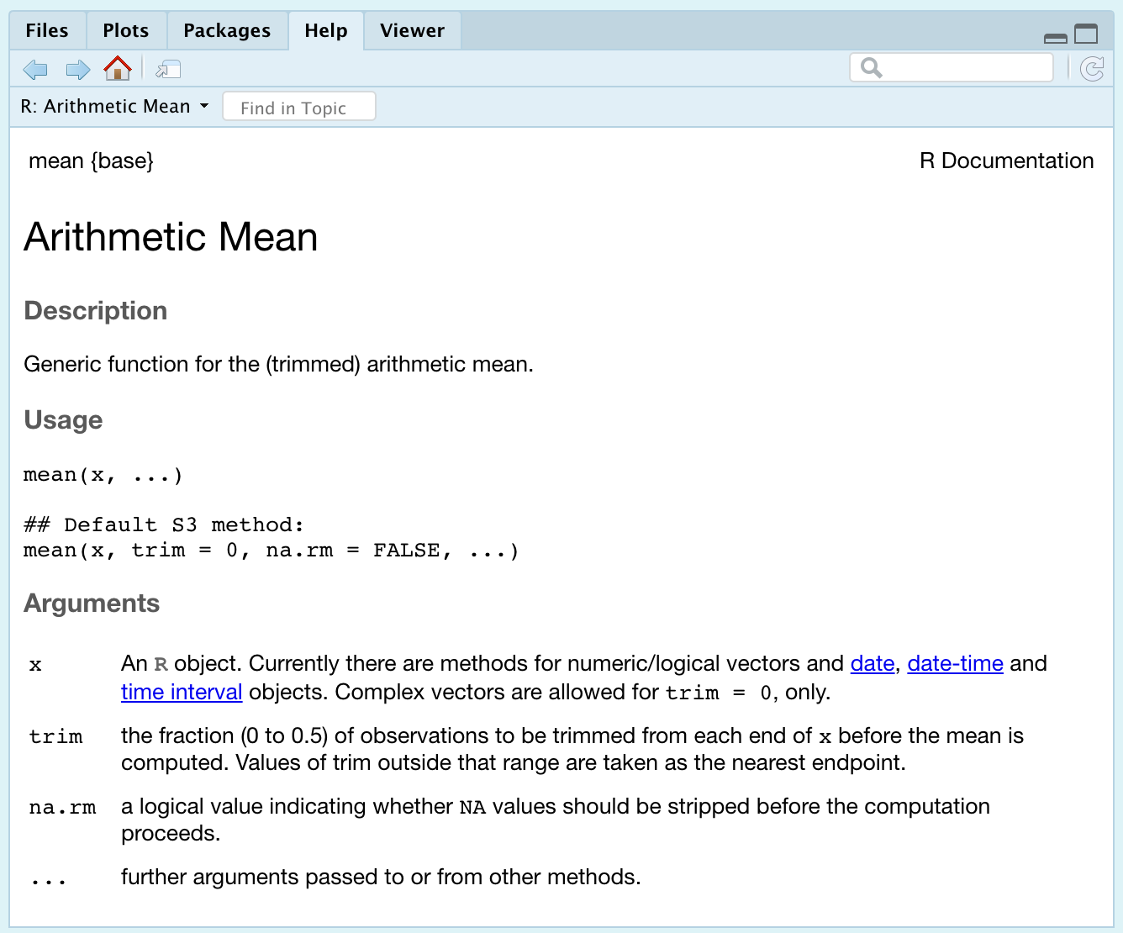
Help! Example

Slide 71
Help! Other Options
Vignette()
Google
Stack Overflow + RStudio Community
GitHub (tread lightly)

Slide 72
Troubleshooting: Clearing Environment
Package conflicts/masks
Declare packages with their functions
Ex: filter() or filter()
Too many objects in the environment to keep track of
Useful cleaning functions
rm( list=ls() )
.rs.restartR()

Slide 73
My Recommended Resources
Online:
Roger Peng and John Leek on Coursera
DataCamp (free and paid options)
https://homerhanumat.github.io/r-notes/index.html
Books:
Beyond Spreadsheets with R
R in Action
In R:
swirl()
RStudio cheatsheets
Notes:
Other books you might encounter:
R 4 Data science: don’t recommend for beginners, but is solid
R in Action 3rd edition: this is a good 2nd book to read
Most books from Manning Publications website are solid
Haven’t fully verify the book by Homer Hanumat, but it was updated just a month ago and seems to cover all the important topics

Slide 74
Questions?
Slides available on my GitHub, NeuroShepherd, in the R_Coding_Presentations folder
Video recording from today’s session will be posted

